Slide 1
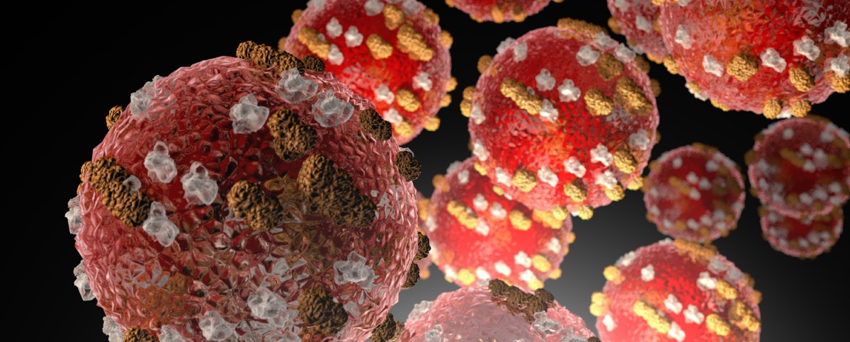

Measles and COVID-19
Through the Lens of Mathematical Models
Kristan A. Schneider, PhD
Professor, Translation Informatics Division & Center for Global Health

Slide 2
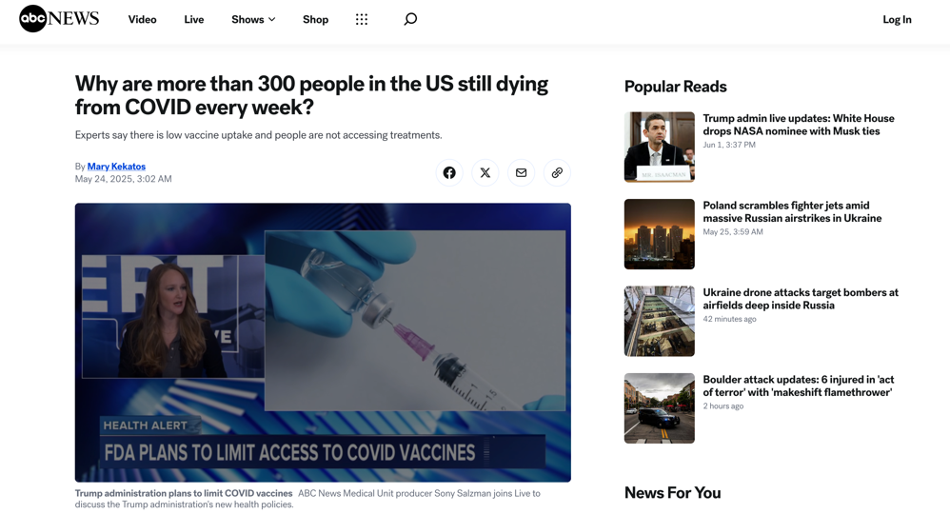
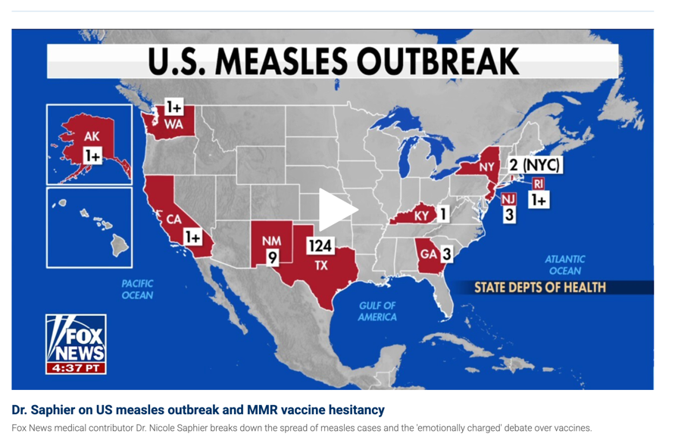
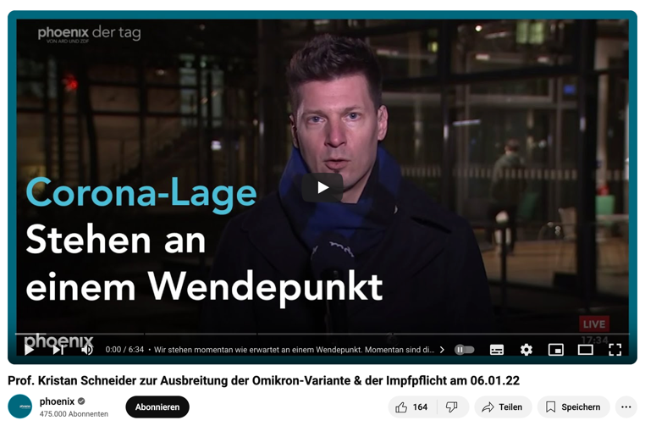

Slide 3
Outline
Facts about measles and COVID-19
Basics of mathematical models for disease spread
How difference and similarities of measles and COVID-19 have to be incorporated into models
Aspects of the vaccine
Disclaimer:
Some simplifications and inaccuracies had to be made
We do not want to talk about pro- or antivaxxers, but what needs to be incorporated into models

Slide 4
1981
Disease | Estimated Infections (1981) | Estimated Deaths (1981)
Measles | ~50–100 million | ~2.6 million Mostly children
Tuberculosis | ~10 million | ~2–3 million
Malaria | ~200–300 million | ~1–2 million
Dengue | ~10–30 million | ~10,000–20,000
Diarrheal diseases | >1 billion | ~3–5 million
Acute respiratory infections (e.g., pneumonia) | Hundreds of millions | >4 million
HIV/AIDS | ~Hundreds of thousands (early stage) | <100,000

Slide 5
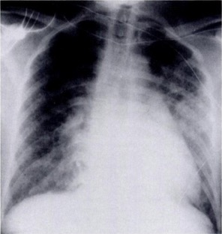
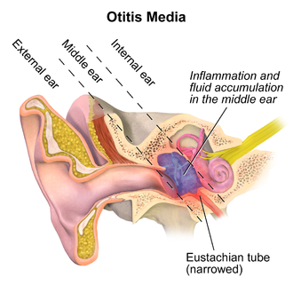
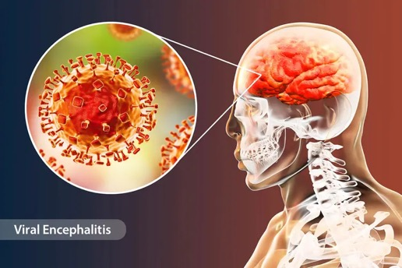
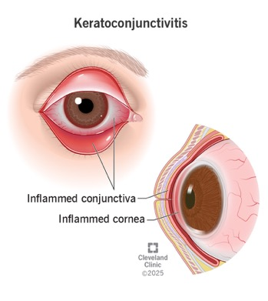
Severe measles infections
Pneumonia (most common cause of measles death): secondary bacterial pneumonia or primary viral
Otitis media: very common in children; can lead to hearing loss
Keratoconjunctivitis: lead to corneal scarring and blindness (especially vitamin A-deficient children)
Acute encephalitis: in 0.1% of cases: risk of permanent brain damage
Subacute sclerosing panencephalitis (SSPE): 7–10 years after measles (in 0.001-0.01%)
Immune amnesia: temporarily suppresses immune memory, increased vulnerability to other infections for months to years
Severe diarrhea and dehydration

Slide 6
SARS-CoV-2
Year | Confirmed Infections | Estimated Infections | Confirmed Deaths | Estimated Deaths (Excess Mortality)
2020 | ~83 million | ~400–800 million | ~1.8 million | ~3–4 million
2021 | ~300 million | ~1.0–1.5 billion | ~3.5 million | ~6–7 million
2022 | ~300 million | ~1.5–2.0 billion | ~1.3 million | ~3–4 million
2023 | ~70 million | ~400–600 million | ~300,000–500,000 | ~1–1.5 million
2024 | ~20 million (as of mid-year) | ~100–300 million | ~100,000–200,000 | ~500,000+ (ongoing estimates)
TOTAL | ~770 million | ~3.5–5.0 billion | ~7 million | ~15–20 million

Slide 7
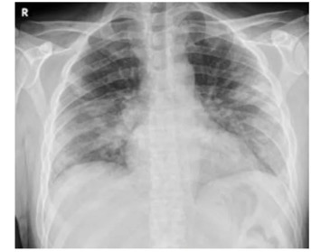
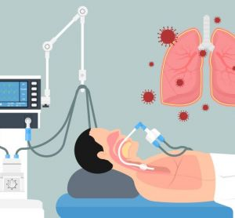
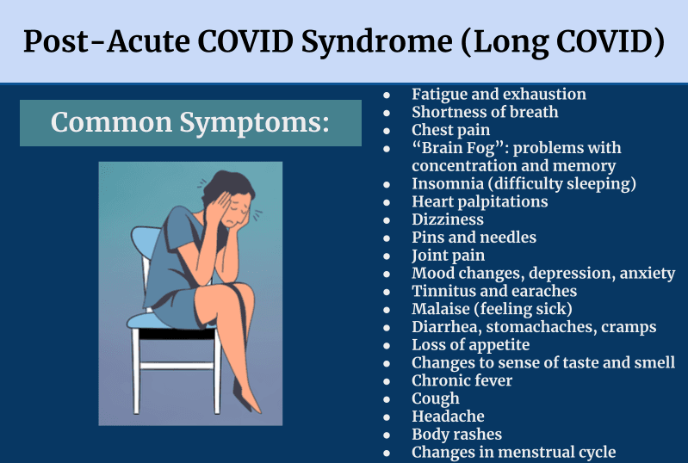
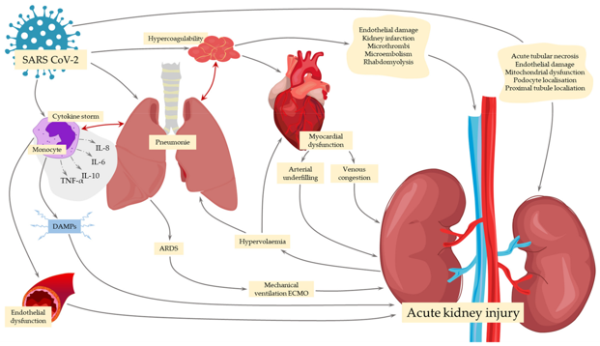
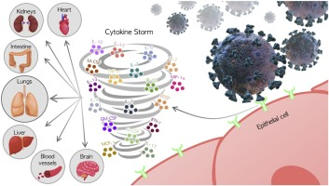
Severe COVID-19 infections
Severe pneumonia: viral pneumonia with bilateral infiltrates, often leading to hypoxemia
Acute Respiratory Distress Syndrome (ARDS): life-threatening lung failure requiring mechanical ventilation in ICU
Cytokine storm: excessive immune response with elevated IL-6, CRP, ferritin → shock, multi-organ damage
Kidney injury: acute kidney injury (AKI), especially in hospitalized or ICU patients
Long COVID/Post-acute sequelae: Fatigue, dyspnea, cognitive dysfunction (“brain fog”), depression, loss of smell/taste lasting weeks to months

Slide 8
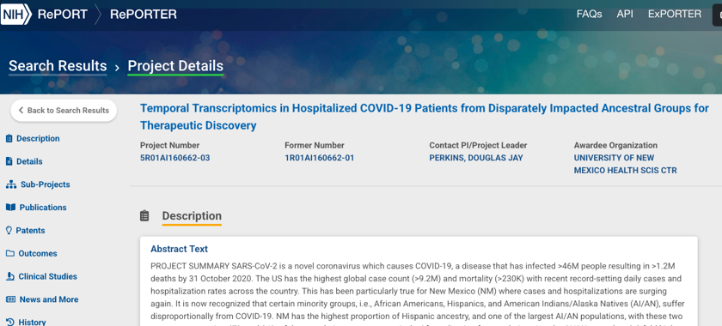
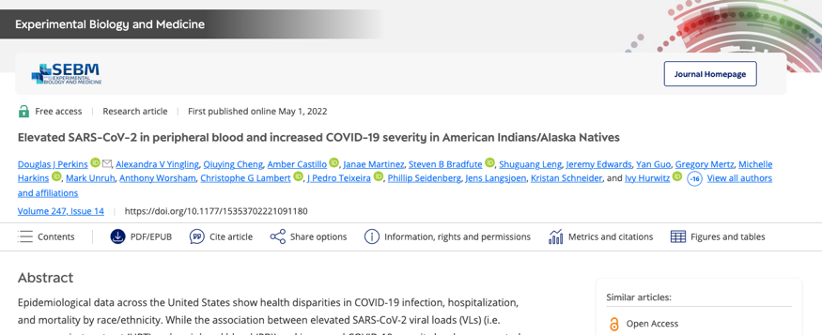

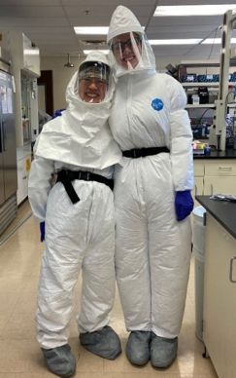
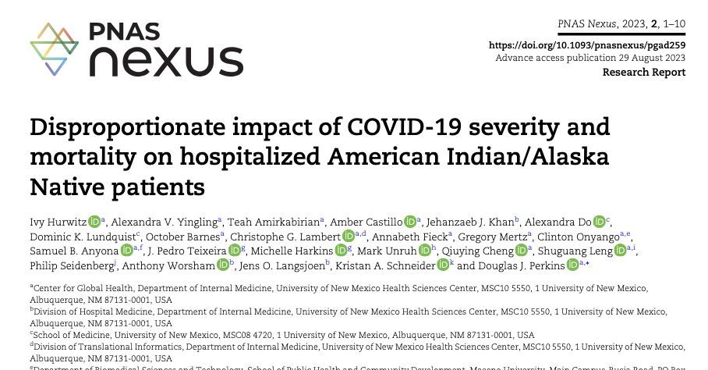
Some COVID-19 research at DOIM
Douglas J Perkins, PhD
Distinguished Professor and Center Director
Center for Global Health

Slide 9
Modeling measles and COVID-19
Measles virus and SARS-CoV-2 both airborne
Both extremely contagious
Vaccine works very well for measles but mainly protects from severe infection in COVID-19
Modeling measles and COVID-19 serve different purposes:
COVID-19:
  Novel virus in previously unexposed population
  Accurately predict the short term spread for pandemic preparedness
  Predict the effect of interventions (general contact reductions, case isolation etc.) on disease transmission
Measles:
  Majority is immunized against measles (through vaccine, or infections)
  Mechanistically understand risk for smaller outbreaks
  Benchmark compliance with recommended vaccines

Slide 10
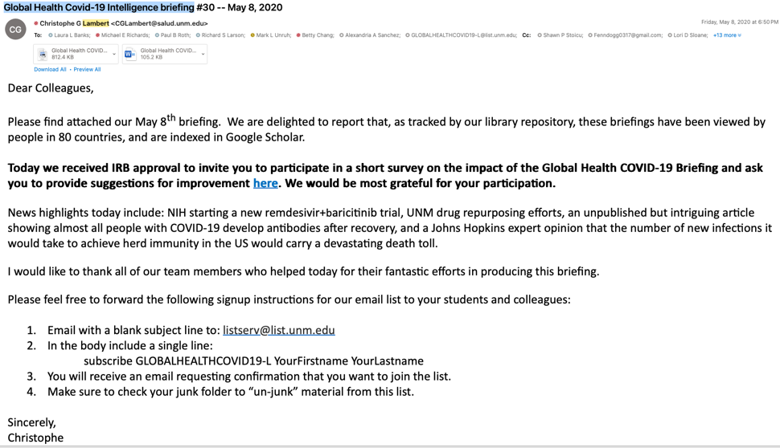

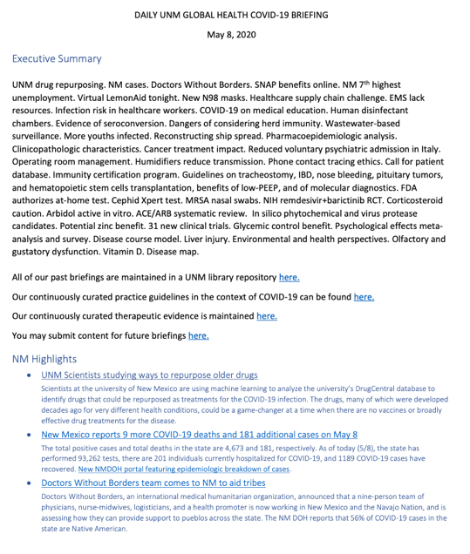
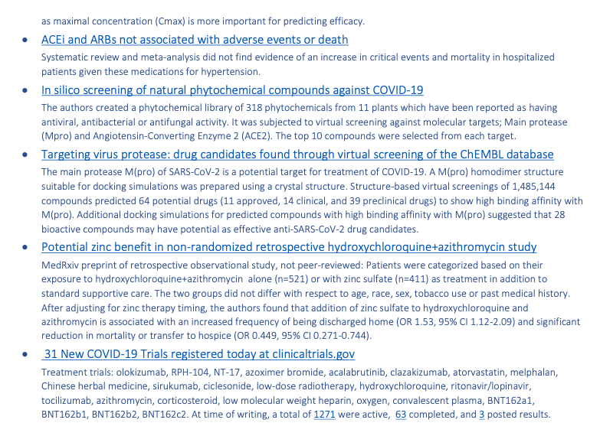
Christophe G Lambert, PhD
Professor and Division Chief
Translational Informatics Division

Slide 11
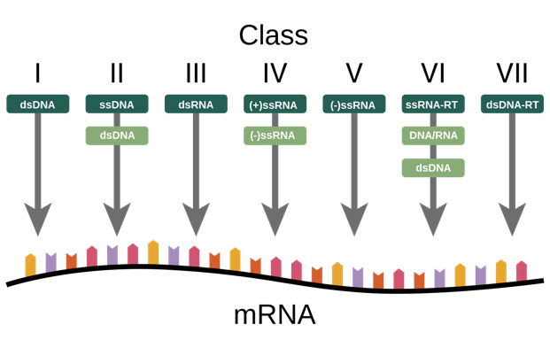
Measles vs. SARS-CoV-2: Virus properties
Property | Measles Virus | SARS-CoV-2
Virus family | Paramyxoviridae | Coronaviridae
Baltimore classification | Class V: (-)ssRNA (negative-sense single-stranded RNA) | Class IV: (+)ssRNA (positive-sense single-stranded RNA)
Genome type | Non-segmented, negative-sense RNA | Non-segmented, positive-sense RNA
Genome length | ~15,894 nucleotides | ~29,903 nucleotides
Genome organization | Encodes 6 structural proteins (N, P, M, F, H, L) | Encodes ~29 proteins (S, E, M, N + multiple ORFs)
Envelope | Yes (lipid envelope) | Yes (lipid envelope)
Capsid symmetry | Helical | Helical
Virion diameter | ~100–200 nm | ~60–140 nm (up to ~160 nm with spikes)
Surface proteins | Hemagglutinin (H), Fusion (F) | Spike (S), Envelope (E), Membrane (M), Nucleocapsid (N)
Host cell entry receptor | CD150 (SLAM), Nectin-4 | ACE2 (Angiotensin-converting enzyme 2)
Replication site | Cytoplasm | Cytoplasm

Slide 12
Measles vs. SARS-CoV-2: Virus properties
Feature | Measles (-)ssRNA | SARS-CoV-2 (+)ssRNA
Genome function upon entry | Not directly translatable (complementary to mRNA) | Directly translatable (functions as mRNA)
Initial step in host cell | Must first transcribe +RNA using viral RNA-dependent RNA polymerase (RdRp) | Host ribosomes can immediately translate viral proteins
Viral polymerase required in virion? | Yes – needs to carry RdRp with it into the host cell | No – can produce RdRp from host ribosomes after entry
Speed of replication | Slower initial replication (must make mRNA first) | Faster initial replication (can translate proteins immediately)
Take home | (-)ssRNA slightly slower early replication | (+)ssRNA very rapid early replication

Slide 13
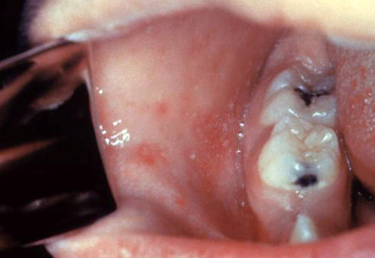
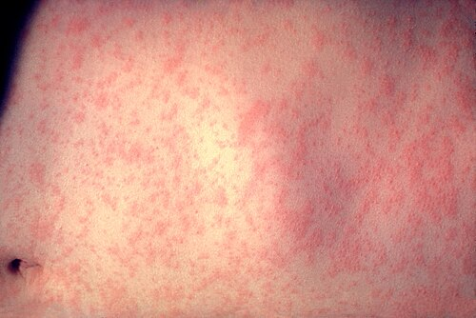
Phases of infection
Phase | Measles | COVID-19 (SARS-CoV-2)
Incubation Period
Prodromal Period
Peak Phase
Late Phase
Recovery
Case fatality
~10–14 days
  ❌No symptoms
  ❌ Not infectious
~2–4 days
  ✅Symptoms: High fever, 3Cs (cough, coryza, conjunctivitis), Koplik spots
  ✅⚠️ Highly infectious
  🔥 Most infectious: ~1 day before Rash Period)
~3–5 days
  ✅Symptoms: fever, 3Cs, maculopapular rash (face → trunk → limbs)
  ✅ Infectious steadily declines
~3–9 days
  ✅Symptoms: rash darkens and fades
  ❌ Not infectious
✅ Permanent immunity
~0.1% – 5%
~2–7 days (median ~3 for Omicron)
  ❌No symptoms
  ❌ Not infectious
~1–3 days
  ✅Mild fever, fatigue, sore throat,
  headache, cough
  ✅ Moderately to highly infectious
~5–7 days
  ✅Full range of symptoms
  ✅🔥 Highly infectious: viral shedding peaks early and declines
~5–7 days
  ✅Symptoms wane
  ✅Infectiousness wanes
❌ Temporal immunity
~2% – 3% (Wildtype)
~0.1% – 0.3% (Omicron)

Slide 14
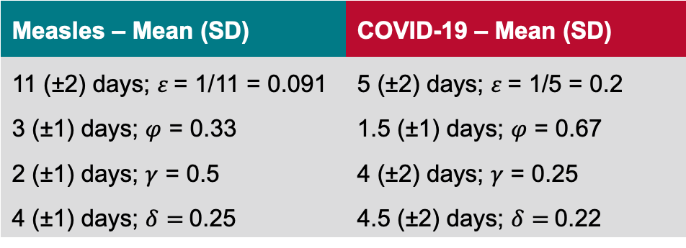

Measles – Mean (SD) | COVID-19 – Mean (SD)
11 (±2) days; $ε$= 1/11 = 0.091 | 5 (±2) days; $ε$= 1/5 = 0.2
3 (±1) days; $φ$ = 0.33 | 1.5 (±1) days; $φ$ = 0.67
2 (±1) days; $γ$ = 0.5 | 4 (±2) days; $γ$ = 0.25
4 (±1) days; $δ=$0.25 | 4.5 (±2) days; $δ=$0.22
Susceptibles (S)
Latent infected (E)
Prodromals (P)
Peak infectious (I)
Late infectious (L)
Recovered (R)
Dead (D)
$λ$… force of infection; contacts S $↔$infected (P+I + L)
$ε, φ, γ, δ$… transition rates
Measles
COVID-19

Slide 15
Measles more contagious than SARS-CoV-2
Basic reproduction number R₀ :
R₀ in measles: 12-18
R₀ in COVID-19: ~11
Basic reproduction number R₀ is the average number of secondary infections of an average index cases in a completely susceptible population (virgin population) without any interventions.
WARNING: R₀ is always defined in the context of a model! The same numerical value can have very different implications for different models!
Important: R₀>1 disease can initially spread, R₀<1 outbreaks self-containing
Important: If disease already prevalent, measures in place etc. → effective reproduction number R_{E}
R₀ depends on properties of the virus and contact behavior in the population
R₀ fluctuates seasonally in measles and COVID-19
Measles
COVID-19

Slide 16
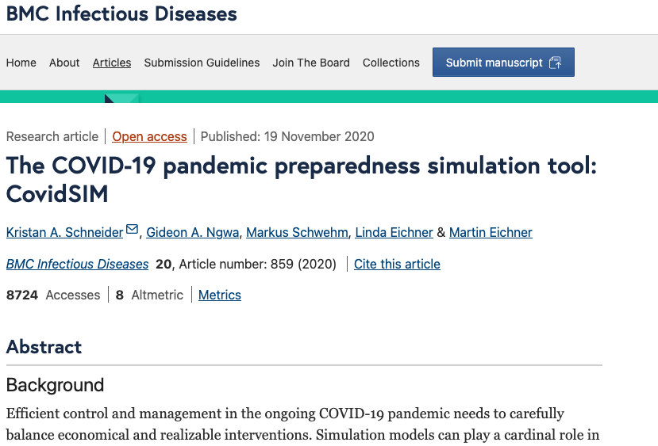
Emphasis on modeling effect of interventions in COVID-19:
General contact reduction (CR) reduced the contact rate of susceptible and infected in force of infection → Delays epidemic peak
Case isolation (Is) reduces number of infected having contacts with susceptibles → Reduces size of epidemic peak
CR and Is reduce effective reproduction number R_{E}
Neither case isolation nor general contact reduction relevant for measles!
Local outbreaks can occur because
R_{E} raises above 1

Slide 17
Severe infections per age group
Measles | COVID-19
Infants (<1 year):
Children (1-4 years):
Children/teenagers (5-19):
Adults (20-49 years):
Older adults (50-64 years):
Elderly (65+ years):
Highest risk of severe disease
High risk of complications like pneumonia, encephalitis
Still significant risk of complications
Complications uncommon
Illness can be more severe than in childhood
Severe infections very uncommon
Generally mild if no comorbidities
Very rare severe infections
Very rare severe infections
Risk of severe outcomes increases with age and comorbidities
Higher risk of severe infections
Highest risk of severe infections (hospitalization, ICU, death)

Slide 18
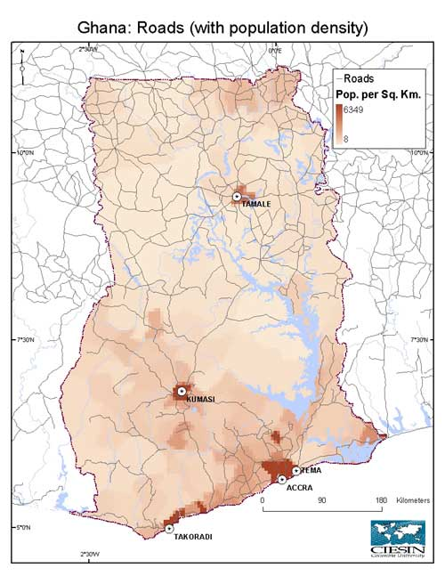
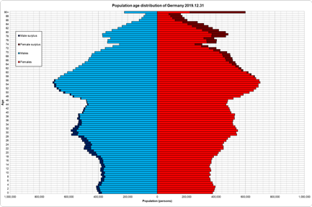
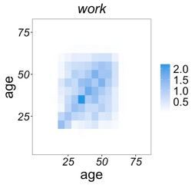
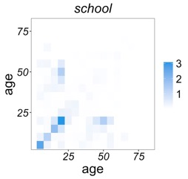
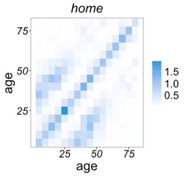
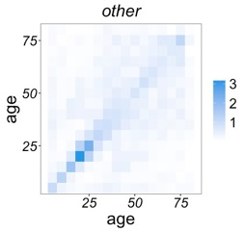
Implications for modelling
Age structure and spatial has to be incorporated in model
Age-dependent context behavior has to be incorporated
→ Allows to model general contact reductions (school closings, home office, etc.) via force of infection

Slide 19
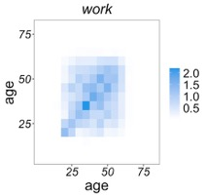
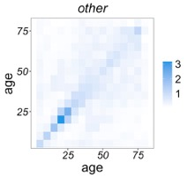
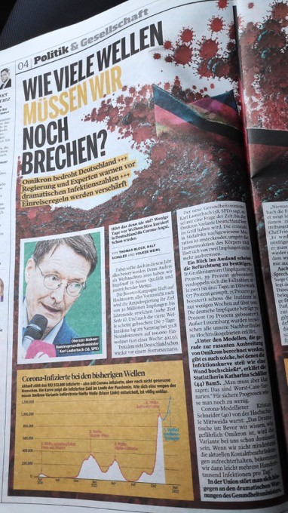

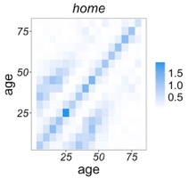
Implications for modelling
COVID-19 models:
Age structure model contact reductions and case isolation time-dependently
Duration of infection and susceptibility age dependent
R_{E} balanced around 1 by interventions
Allows to predict age-dependent mortality
Important for science communication

Slide 20
Measles vs. SARS-CoV-2: virus properties
Feature | Measles virus | SARS-CoV-2 (COVID-19 virus)
Mutation rate (per site)
Mutation rate (overall)
Proofreading
mechanism
Antigenic drift
Impact on vaccine
efficacy
~10⁻⁶–10⁻⁵ mutations/site/replication cycle
Very low: ~1–2 mutations per genome per year
No – lacks proofreading
Very low – measles virus is antigenically stable
Very low – one vaccine effective for decades
~10⁻⁶–10⁻⁴ mutations/site/replication cycle
~1–2 mutations per genome per month (depends on variant)
Yes – nsp14 exonuclease (rare among RNA viruses)
Moderate to High – frequent emergence of variants (e.g., Delta, Omicron)
Moderate to high – variants can partially escape immunity

Slide 21
COVID-19:
Different viral variants have to be considered
Measles:
No need to model different variants

Slide 22
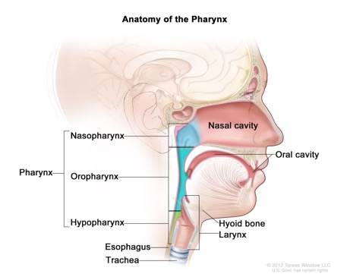
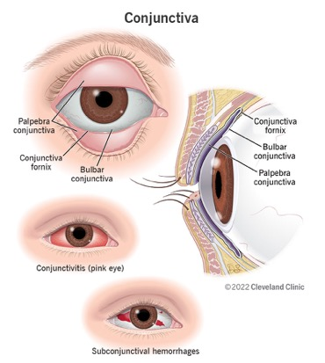
How Measles Virus Enters and Replicates in the Human Body
Entry into the Host:
  Route: Inhalation of infectious droplets or aerosol particles.
  Primary site of entry: Upper respiratory tract (nasopharynx, conjunctiva).
Initial Infection and Replication:
  Alveolar macrophages and dendritic cells in the respiratory epithelium.
  Replication begins in these immune cells in the respiratory mucosa.
Spread to Lymphoid Tissue:
  Infected dendritic cells and macrophages migrate to regional lymph nodes.
  Measles virus amplifies in lymphoid tissues, infecting B and T lymphocytes that also express CD150.
Viremia (Systemic Spread):
  Virus enters bloodstream in infected lymphocytes, causing primary viremia (3–5 days after exposure).
  Dissemination to skin, liver, kidney, conjunctiva, and CNS.
Secondary Targeting of Epithelial Cells:
  Virus spreads to epithelial cells via the receptor Nectin-4 (PVRL4), which is highly expressed in:
    Tracheal and bronchial epithelium
    Conjunctiva
    Skin
Resolution and Immunity
  A robust immune response clears the virus.
  Lifelong immunity through neutralizing antibodies, memory B and T cells

Slide 23
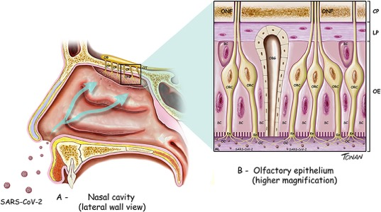
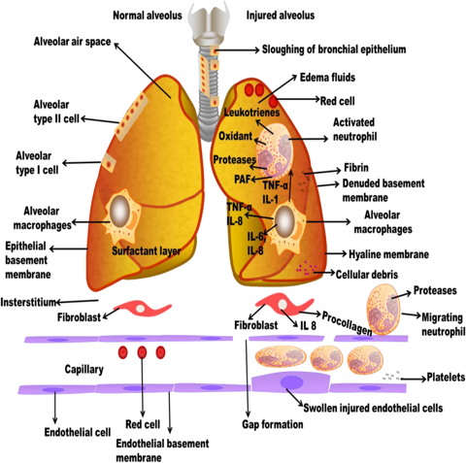
Entry into the Host
  Route: Inhalation of respiratory droplets, aerosols, or contact with contaminated surfaces + mucosal contact (nose, eyes, mouth).
  Primary site of entry: Upper respiratory tract — especially the nasal epithelium.
Attachment to Host Cells
  SARS-CoV-2 spike (S) protein binds to ACE2 (Angiotensin-Converting Enzyme 2) receptor on host cells.
  ACE2 is highly expressed in:
    Nasal epithelium
    Upper and lower airway epithelial cells
    Alveolar epithelial cells (type II pneumocytes)
    Gastrointestinal tract
    Endothelial cells, kidneys, heart
Local Spread in Respiratory Tract
  Virus spreads cell-to-cell and throughout the respiratory epithelium.
  Damages epithelial barriers → leads to inflammation, loss of cilia, and impaired mucociliary clearance.
Systemic Spread
  Viremia (virus in the blood) is less common and often transient.
  Virus can affect multiple organ systems:
    Lungs: primary site of pathology (viral pneumonia, ARDS)
    Heart: myocarditis, endothelial dysfunction
    Kidneys, gut, nervous system: via ACE2-expressing cells
  Immune dysregulation and cytokine storm drive systemic symptoms and complications.

Slide 24
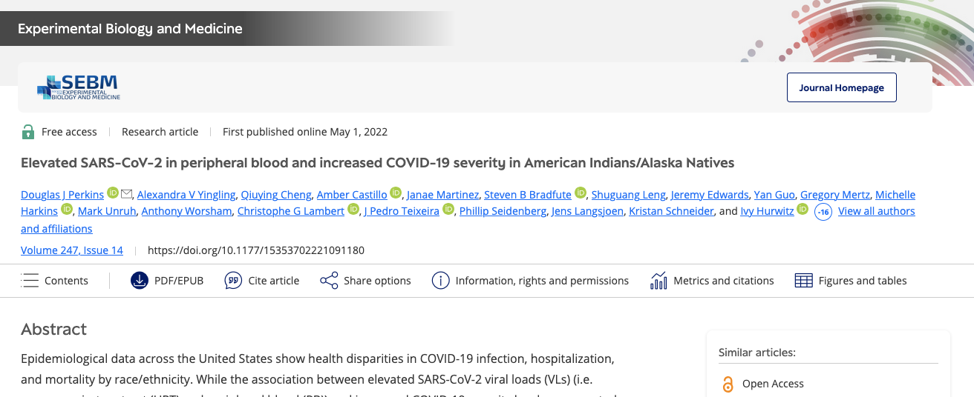
Viral load in blood associated with severe disease

Slide 25
COVID-19:
Several vaccines have to be modelled (particular during the initial rollout)
Susceptibles can be:
  Non-vaccinable (antivaxxers, etc.)
  Waiting to get vaccinated
  Vaccinated but immune outcome is pending
  (e.g. initial Astra-Zeneca vaccination schedule long time horizon for predictions)
  Partially immunized
Same stratification for all phases of the infection
Measles:
Modelling one vaccine is sufficient

Slide 26
COVID-19 with onset of Omicron necessary to model:
Booster vaccines
Immune waning
Reinfection
Measles no need for:
Booster vaccines
Immune waning
Reinfection

Slide 27
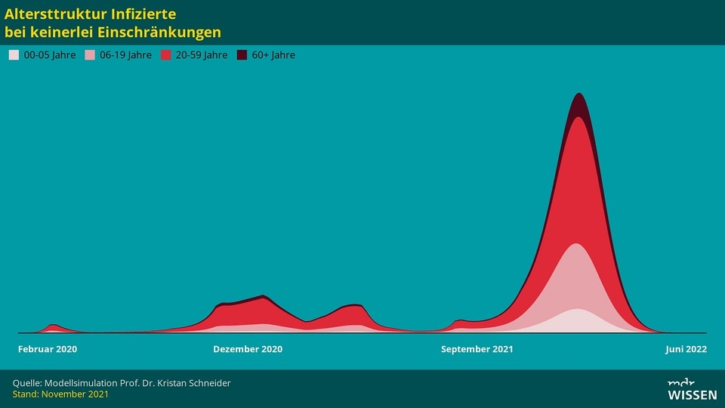

Slide 28
Measles:
One variant
One vaccine
No immune waning
No booster
No reinfection
No contact reductions
No case isolation
Large part of population is already immunized (high vaccination coverage)
Smaller communities can have low vaccination coverage

Slide 29
Hypothetical parameters
Mimic small community with low vaccination coverage in California
Small community surrounded by large community with higher vaccination coverage
R_{E} around 1, but high R₀ (=11) with seasonal fluctuations
Scenario cnan lead to outbreak waves
Infections disproportionally high in young children
Infections disproportionally high in unvaccinated

Slide 30

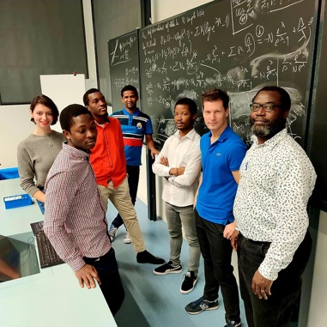
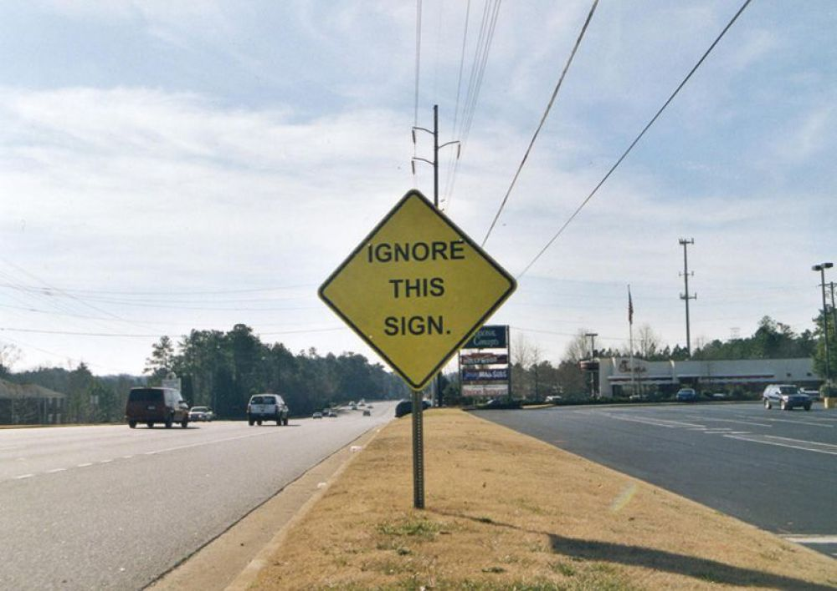
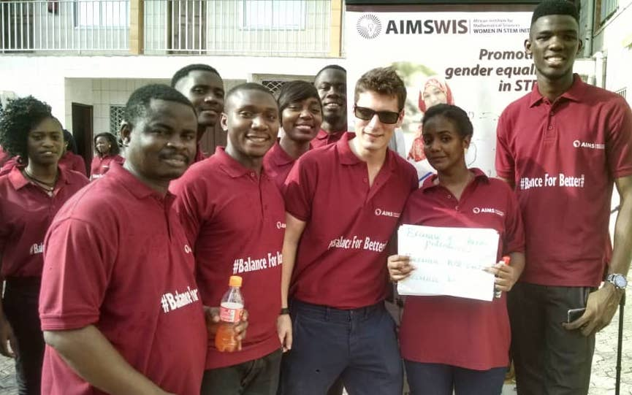
Christian Tsoungui Obama, MSc
Kristina Helle, PhD
Richard Vogel, MSc
Meraj Hashemi, MSc
Nessma Adil Yousif, MSc
Loyce Kayanula, MSc
Arlinda Sadiku, MSc
Geroge Kamage, MSc
Aliou Bouba, MSc
Iyanda Sulyman
Pierre Ngougoue Ngougoue, MSc
Frank Ngaha, MSc
Patience Illyia, MSc
Loli Alawam, MSc
Toheeb Ibrahim, MSc
Grima Zelleke, MSc
Jorgon Ngucho, MSc
University of Tübingen/Explosys/Epimos
Prof. Martin Eichner
Dr. Markus Schwehm

Slide 31
COVID-19 in 2020: ~1.8-4.0 million deaths
Measles in 1981: ~3.6 million deaths
What is more concerning?

Slide 33
1981
Disease | Estimated Infections (1981) | Estimated Deaths (1981) | Notes
Measles | ~50–100 million | ~2.6 million | Mostly children; deaths due to complications (pneumonia, encephalitis, malnutrition)
Tuberculosis | ~10 million | ~2–3 million | Mostly adults
Malaria | ~200–300 million | ~1–2 million | Primarily children in sub-Saharan Africa
Dengue | ~10–30 million | ~10,000–20,000 | Underreported; deaths from severe dengue (DHF/DSS)
Diarrheal diseases | >1 billion | ~3–5 million | Mostly children; often caused by rotavirus, E. coli, cholera
Acute respiratory infections (e.g., pneumonia) | Hundreds of millions | ~4 million+ | Leading cause of child mortality globally
HIV/AIDS | ~Hundreds of thousands (early stage) | <100,000 | Epidemic had just begun; first cases described in 1981

Slide 36
Vaccine and immunity
Vaccine type:
Antibody types:
Targeted viral site:
Sterilizing immunity:
Duration of protection:
Live attenuated (e.g., MMR: Measles-Mumps-Rubella)
Strong IgG and some IgA via systemic & mucosal spread
Systemic & respiratory: Measles replicates in immune and epithelial cells
✅ Yes: prevents infection and transmission
Lifelong (after 1–2 doses in most cases)
mRNA (Pfizer, Moderna), viral vector (AstraZeneca, J&J), inactivated (Sinovac)
Primarily IgG (intramuscular vaccines); low mucosal IgA
Very rare severe infections
Risk of severe outcomes increases with age and comorbidities
Higher risk of severe infections
Highest risk of severe infections (hospitalization, ICU, death)

Slide 41
Phase | Measles | COVID-19 (SARS-CoV-2)
Incubation Period | ~10–1 4 days ❌No symptoms ❌ Not infectious | ~2–7 days (median ~3 for Omicron) ❌No symptoms ❌ Not infectious
Prodromal Period | ~2–4 days ✅Symptoms: High fever, 3Cs (cough, coryza, conjunctivitis), Koplik spots ✅⚠️ Highly infectious 🔥 Most infectious: ~1 day before Rash Period) | ~1–3 days ✅Mild fever, fatigue, sore throat, headache, cough ✅ Moderately to highly infectious
Peak Phase | ~3–5 days ✅Symptoms: fever, 3Cs, maculopapular rash (face → trunk → limbs) ✅ Infectious steadily declines | ~5–7 days ✅Full range of symptoms ✅🔥 Highly infectious: viral shedding peaks early and declines
Late Phase | ~3–9 days ✅Symptoms: rash darkens and fades ❌ Not infectious | ~5–7 days ✅Symptoms wane ✅Infectiousness wanes
Recovery | ✅ Permanent immunity | ❌ Temporal immunity
Case fatality | ~0.1% – 5% | ~2% – 3% (Wildtype) ~0.1% – 0.3% (Omicron)

Slide 42
Measles vs. SARS-CoV-2: virus properties
Feature | Measles virus | SARS-CoV-2 (COVID-19 virus)
Genome type | Negative-sense single-stranded RNA (−ssRNA) | Positive-sense single-stranded RNA (+ssRNA)
Mutation rate (per site) | ~10⁻⁶ to 10⁻⁵ mutations/site/replication cycle | ~10⁻⁶ to 10⁻⁴ mutations/site/replication cycle
Mutation rate (overall) | Very low: ~1–2 mutations per genome per year | ~1–2 mutations per genome per month (depends on variant)
Proofreading mechanism | No — lacks proofreading | Yes — nsp14 exonuclease (rare among RNA viruses)
Antigenic drift | Very low — measles virus is antigenically stable | Moderate to High — frequent emergence of variants (e.g., Delta, Omicron)
Impact on vaccine efficacy | Very low — one vaccine effective for decades | Moderate to high — variants can partially escape immunity

Slide 43
Measles vs. SARS-CoV-2: virus properties
Feature | Measles virus | SARS-CoV-2 (COVID-19 virus)
Genome type | Negative-sense single-stranded RNA (−ssRNA) | Positive-sense single-stranded RNA (+ssRNA)
Mutation rate (per site) | ~10⁻⁶ to 10⁻⁵ mutations/site/replication cycle | ~10⁻⁶ to 10⁻⁴ mutations/site/replication cycle
Mutation rate (overall) | Very low — ~1–2 mutations per genome per year | ~1–2 mutations per genome per month (depends on variant)
Proofreading mechanism | No — lacks proofreading | Yes — nsp14 exonuclease (rare among RNA viruses)
Antigenic drift | Very low — measles virus is antigenically stable | Moderate to High — frequent emergence of variants (e.g., Delta, Omicron)
Impact on vaccine efficacy | Very low — one vaccine effective for decades | Moderate to high — variants can partially escape immunity

Slide 44
Phase | Measles | COVID-19 (SARS-CoV-2)
Incubation Period | ~10–14 days (range: 7–21 days) | ~2–14 days (median ~5 days for earlier variants; Omicron: ~2–4 days)
Symptoms (Incubation) | None (asymptomatic) | None or very mild symptoms
Prodromal Phase | ~2–4 days | ~1–3 days
Symptoms (Prodromal) | High fever, cough, coryza (runny nose), conjunctivitis | Low-grade fever, sore throat, fatigue, headache, myalgia
Infectious Period | ~4 days before to 4 days after rash onset | ~2 days before to ~8–10 days after symptom onset (milder or shorter with Omicron)
Symptoms (Peak/Active) | Maculopapular rash (face → body), high fever, malaise, cough, conjunctivitis | Cough, fever, fatigue, dyspnea, sore throat, chest pain, loss of taste/smell, GI symptoms
Late Stage / Recovery | Rash fades, peeling skin, immune recovery; complications: pneumonia, encephalitis | Recovery or progression to complications (pneumonia, long COVID, ARDS)
Contagious When? | Very contagious: ~4 days before to 4 days after rash onset | Highly contagious, especially ~2 days before to ~5 days after symptom onset
R0 (Basic Reproduction) | 12–18 | 2–3 (original), up to 10+ for Omicron variants

Slide 45
Phase | Measles | COVID-19 (SARS-CoV-2)
Incubation Period | ~10–14 days (range 7–21) ❌No symptoms ❌ Not infectious | ~2–7 days (median ~3 for Omicron) ❌No symptoms ❌ Not infectious
Prodromal Period | ~2–4 days ✅Symptoms: High fever, 3Cs (cough, coryza, conjunctivitis), Koplik spots ✅⚠️ Highly infectious 🔥 Most infectious: ~1 day before Rash Period) | ~1–3 days ✅Mild fever, fatigue, sore throat, headache, cough ✅ Moderately to highly infectious
Peak Phase | ~3–5 days ✅Symptoms: fever, 3Cs, maculopapular rash (face → trunk → limbs) ✅ Infectious steadily declines | ~5–7 days ✅Full range of symptoms ✅🔥 Highly infectious: viral shedding peaks early and declines
Late Phase | ~3–9 days ✅Symptoms: rash darkens and fades ❌ Not infectious | ~5–7 days ✅Symptoms wane ✅Infectiousness wanes
Recovery | ✅ Permanent immunity | ❌ Temporal immunity
Case fatality | ~0.1% – 5% | ~2% – 3% (Wildtype) ~0.1% – 0.3% (Omicron)

